Slide 1
CMS Data Lake Pilot
Jayaprakash Subramani

Slide 2
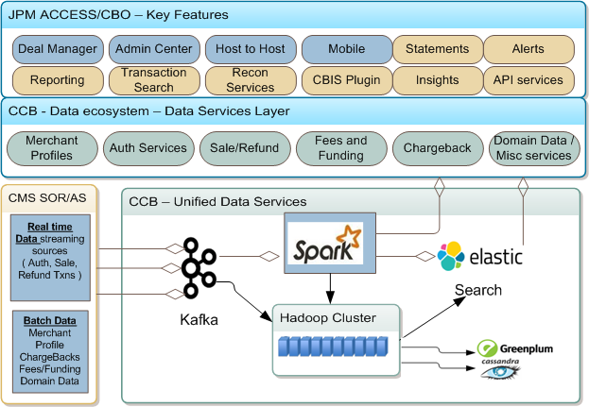
CMS Target State view – Data Lake integration with Access and CBO
1
2
3
4
5
7
7
8
6
9

Slide 3
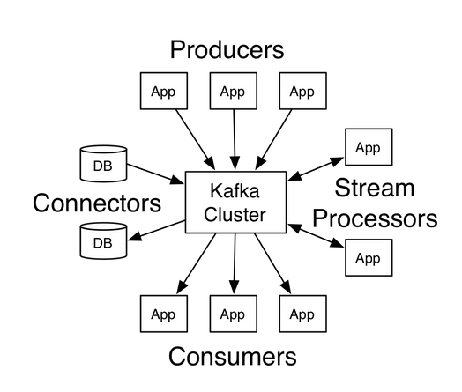
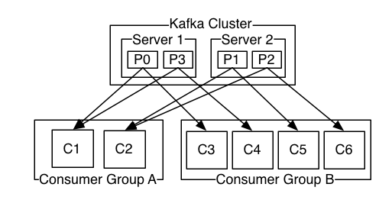
Kafka as a distributed streaming platform

Slide 4

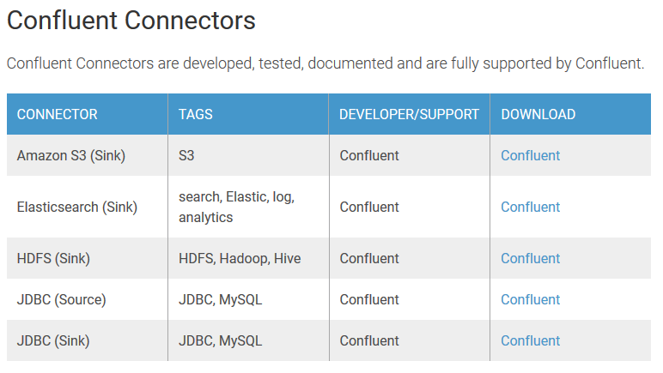
Other Certified Connectors - https://www.confluent.io/product/connectors/

Slide 5
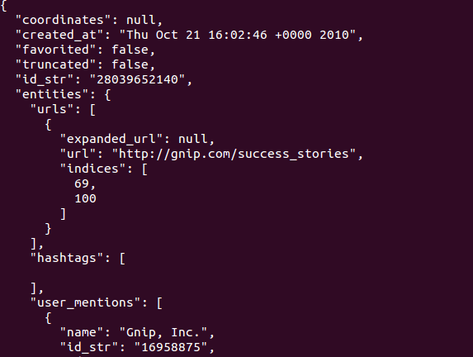
My POC
Sample Json Source

Slide 6
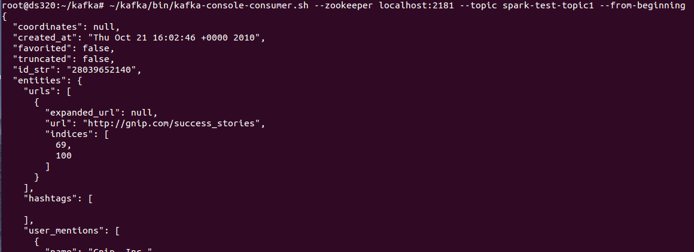
Create a Topic and Start Streaming the Data Source
root@ds320:~/kafka# ~/kafka/bin/kafka-console-producer.sh --broker-list localhost:9092 --topic spark-test-topic1 </root/kafka/Twitter.txt
Test Using Kafka Consumer:

Slide 7
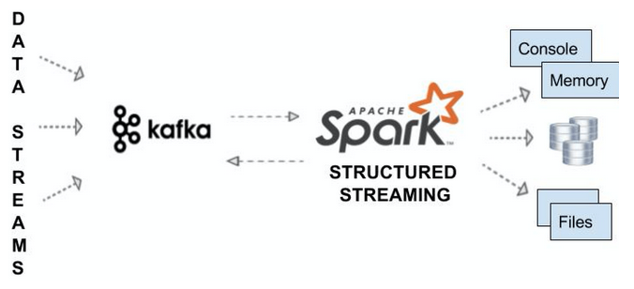
Lets Do Spark Streaming

Slide 8
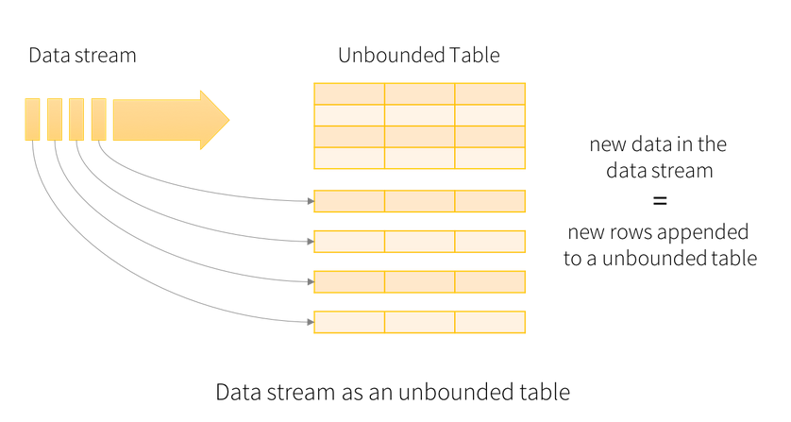
Structured Streaming in Spark 2.0

Slide 9
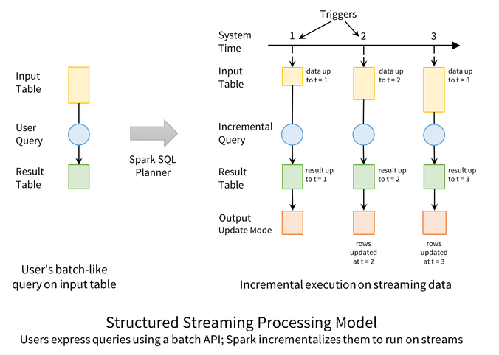
Structured Streaming

Slide 10
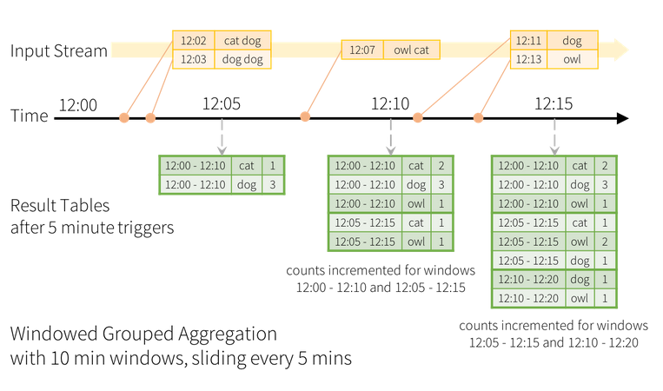
Window Functions

Slide 11
Lets Get Back to POC – Just print the streamed data in Spark Memory Console
Spark Code:
val ssc = new StreamingContext(sc, Seconds(5))
val kafkaConf = Map(
"metadata.broker.list" -> "localhost:9092",
"zookeeper.connect" -> "localhost:2181",
"group.id" -> "kafka-streaming-example",
"zookeeper.connection.timeout.ms" -> "1000"
)
val lines = KafkaUtils.createStream[Array[Byte], String, DefaultDecoder, StringDecoder](
ssc,
kafkaConf,
Map("TutorialTopic" -> 1), // subscripe to topic and partition 1
StorageLevel.MEMORY_ONLY
)
lines.print()
ssc.start()

Slide 12
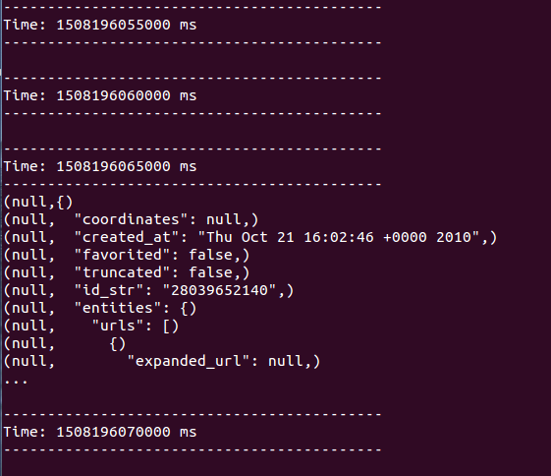
Streaming Output in Console

Slide 13
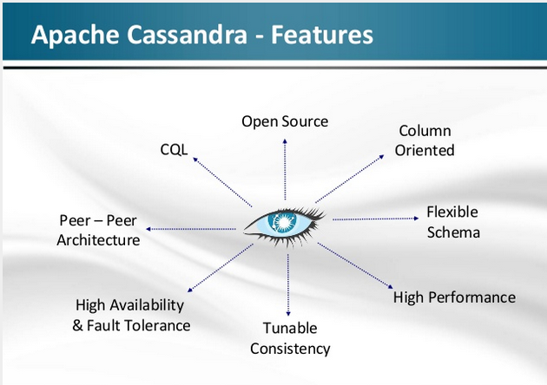
Cassandra

Slide 14
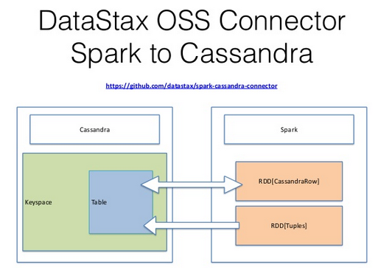

Slide 15
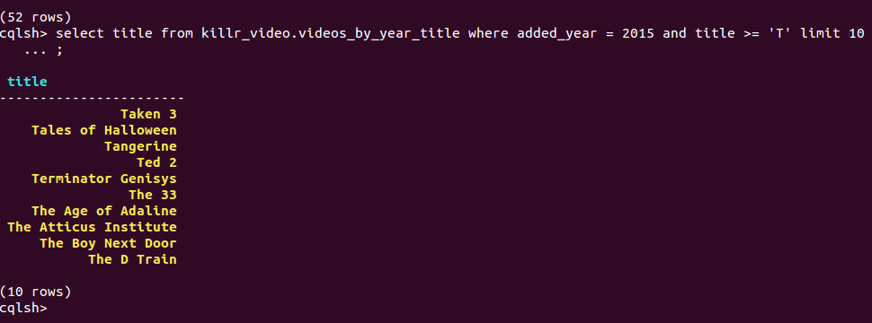
Get Back to POC – Some memory issues in my VM so not a full fledged POC but proved that Spark talks to Cassandra

Slide 16
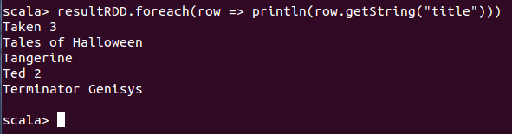
Get Back to POC – Some memory issues in my VM so not a full fledged POC but proved that Spark talks to Cassandra
val qryPart1 = sc.cassandraTable("killr_video", "videos_by_year_title").select("title")
val qryPart2 = qryPart1.where("added_year = 2015 and title >= 'T'").limit(5)
val resultRDD = qryPart2.collect
resultRDD.foreach(row => println(row.getString("title")))

